Slide 1
Chapter 1
An Introduction to Computer Science

Slide 2
Learning Objectives
Understand the definition of the term algorithm
Understand the formal definition of computer science
Write down everyday algorithms
Determine if an algorithm is ambiguous or not effectively computable
Understand the roots of modern computer science in mathematics and mechanical machines
Summarize the key points in the historical development of modern electronic computers

Slide 3
Introduction
Common misconceptions about computer science:
  Computer science is the study of computers.
  Computer science is the study of how to write computer programs.
  Computer science is the study of the uses and applications of computers and software.

Slide 4
The Definition of Computer Science (1 of 4)
Computer science is the study of algorithms, including:
  Their formal and mathematical properties
  Their hardware realizations
  Their linguistic realizations
  Their applications

Slide 5
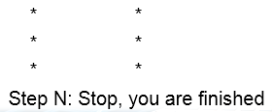
The Definition of Computer Science (2 of 4)
The informal definition of an algorithm:
  An ordered sequence of instructions that is guaranteed to solve a specific problem. For example:
    Step 1: Do something
    Step 2: Do something
    Step 3: Do something

Slide 6
The Definition of Computer Science (3 of 4)
Operations used to construct algorithms:
  Sequential operations
    Carries out a single well-defined task
  Conditional operations
    Ask a question and the next operation is then selected on the basis of the answer to that question
  Iterative operations
    Looping instructions that tell not to go on but go back and repeat the execution of a previous block of instructions

Slide 7
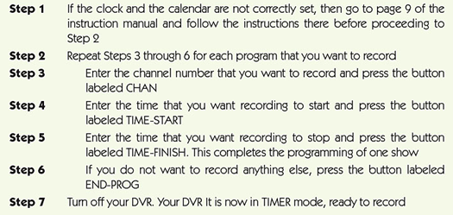
Figure 1.1 Programming your DVR: An example of an algorithm

Slide 8
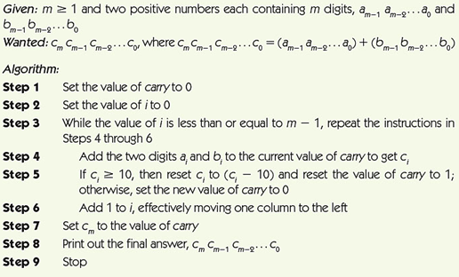
Figure 1.2 Algorithm for adding two m-digit numbers

Slide 9
The Definition of Computer Science (4 of 4)
Why are formal algorithms so important in computer science?
  If we can specify an algorithm to solve a problem, then we can automate its solution
Computing agent
  Machine, robot, person, or thing carrying out the steps of the algorithm
Unsolved problems
  Some problems are unsolvable, some solutions are too slow, and some solutions are not yet known

Slide 10
Algorithms (1 of 5)
The Formal Definition of an Algorithm:
  A well-ordered collection of unambiguous and effectively computable operations that, when executed, produces a result and halts in a finite amount of time

Slide 11
Algorithms (2 of 5)
Well-ordered collection
  Upon completion of an operation, we always know which operation to do next
Unambiguous and effectively computable operations
  It is not enough for an operation to be understandable, it must also be doable (effectively computable)
  Ambiguous statements
    Go back and do it again (Do what again?)
    Start over (From where?)

Slide 12
Algorithms (3 of 5)
Produces a result and halts in a finite amount of time
  To know whether a solution is correct, an algorithm must produce a result that is observable to a user:
    A numerical answer
    A new object
    A change in the environment

Slide 13
Algorithms (4 of 5)
Unambiguous operation, or primitive
  Can be understood by the computing agent without having to be further defined or simplified
It is not enough for an operation to be understandable
  It must also be doable (effectively computable) by the computing agent
Infinite loop
  Runs forever
  Usually a mistake

Slide 14
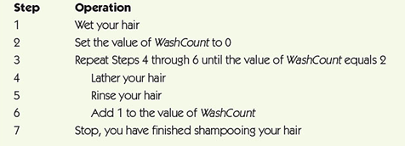
Figure 1.3 A correct solution to the shampooing problem

Slide 15
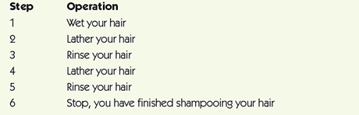
Figure 1.4 Another correct solution to the shampooing problem

Slide 16
Algorithms (5 of 5)
The Importance of Algorithmic Problem Solving
  “Industrial revolution” of the nineteenth century
    Mechanized and automated repetitive physical tasks
  “Computer revolution” of the twentieth and twenty-first centuries
    Mechanized and automated repetitive mental tasks
    Used algorithms and computer hardware

Slide 17
A Brief History of Computing The Early Period: Up to 1940 (1 of 7)
Seventeenth century: automation/simplification of arithmetic for scientific research:
  John Napier invented logarithms as a way to simplify difficult mathematical computations (1614).
  The first slide rule appeared around 1622.
  Blaise Pascal designed and built a mechanical calculator named the Pascaline (1642).
  Gottfried Leibnitz constructed a mechanical calculator called Leibnitz’s Wheel (1673).

Slide 18
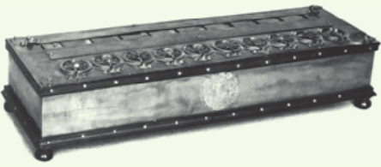
Figure 1.5 The pascaline, one of the earliest mechanical calculators
Source: INTERFOTO/Alamy

Slide 19
A Brief History of Computing The Early Period: Up to 1940 (2 of 7)
Seventeenth century devices:
  Could represent numbers
  Could perform arithmetic operations on numbers
  Did not have a memory to store information
  Were not programmable (a user could not provide a sequence of actions to be executed by the device)

Slide 20
A Brief History of Computing The Early Period: Up to 1940 (3 of 7)
Nineteenth-century devices:
  Joseph Jacquard designed an automated loom that used punched cards to create patterns (1801)
  Herman Hollerith (1880s onward)
    Designed and built programmable card-processing machines to read, tally, and sort data on punched cards for the U.S. Census Bureau
    Founded a company that became IBM in 1924

Slide 21
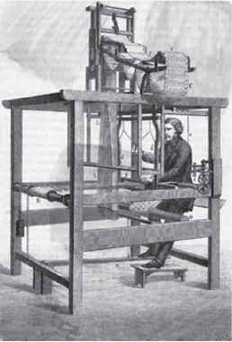
Figure 1.6 Drawing of the Jacquard loom
Source: © Bettmann/CORBIS

Slide 22
A Brief History of Computing The Early Period: Up to 1940 (4 of 7)
Luddites
  Originally opposed to the new manufacturing technology introduced by the Jacquard Loom
  Now a term used to describe any group that is frightened or angered by the latest developments in any branch of science and technology, including computers

Slide 23
A Brief History of Computing The Early Period: Up to 1940 (5 of 7)
Charles Babbage
  Difference Engine designed and built in 1823
    Could do addition, subtraction, multiplication, and division to six significant digits
    Could solve polynomial equations and other complex mathematical problems

Slide 24
A Brief History of Computing The Early Period: Up to 1940 (6 of 7)
Charles Babbage
  Analytical Engine
    Designed but never built
    Mechanical, programmable machine with parts that mirror that of a modern-day computer:
      Mill: Arithmetic/logic unit
      Store: Memory
      Operator: Processor
      Output Unit: Input/Output

Slide 25
A Brief History of Computing The Early Period: Up to 1940 (7 of 7)
Nineteenth-century devices:
  Were mechanical, not electrical
  Had many features of modern computers:
    Representation of numbers or other data
    Operations to manipulate the data
    Memory to store values in a machine-readable form
    Programmable: sequences of instructions could be predesigned for complex operations

Slide 26
A Brief History of Computing The Birth of Computers: 1940–1950 (1 of 5)
Mark I (1944)
  Electromechanical computer used a mix of relays, magnets, and gears to process and store data
Colossus (1943)
  General-purpose computer built by Alan Turing for the British Enigma project
ENIAC (Electronic Numerical Integrator and Calculator) (1946)
  First publicly known fully electronic computer

Slide 27
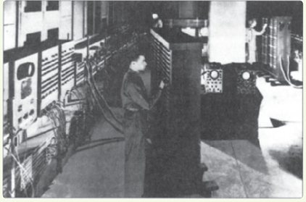
Figure 1.7 Photograph of the ENIAC computer
Source: From the Collections of the University of Pennsylvania Archives (U.S Army photo)

Slide 28
A Brief History of Computing The Birth of Computers: 1940–1950 (2 of 5)
John Von Neumann
  Proposed a radically different computer design based on a model called the stored program computer
  Research group at the University of Pennsylvania built one of the first stored program computers, called EDVAC, in 1949
  UNIVAC I, a version of EDVAC, the first commercially sold computer
  Nearly all modern computers use the Von Neumann architecture

Slide 29
A Brief History of Computing The Modern Era: 1950 to the Present (3 of 5)
First generation of computing (1950–1957)
  Similar to EDVAC
  Vacuum tubes for processing and storage
  Large, expensive, and delicate
  Required trained users and special environments
Second generation (1957–1965)
  Transistors and magnetic cores instead of vacuum tubes
  Era of FORTRAN and COBOL: some of the first high-level programming languages

Slide 30
A Brief History of Computing The Modern Era: 1950 to the Present (4 of 5)
Third generation (1965–1975)
  Era of the integrated circuit
  Birth of the first minicomputer: desk-sized, not room-sized, computers
  Birth of the software industry
Fourth generation (1975–1985)
  The first microcomputer: desktop machine
  Development of widespread computer networks
  Electronic mail, graphical user interfaces, and embedded systems

Slide 31
A Brief History of Computing The Modern Era: 1950 to the Present (5 of 5)
Fifth generation (1985–?)
  Massively parallel processors capable of quadrillions (10¹⁵) of computations per second
  Handheld digital devices
  Powerful multimedia user interfaces incorporating sound, voice recognition, video, and television
  Wireless communications
  Massive cloud storage devices
  Ubiquitous computing
  Ultra-high-resolution graphics and virtual reality

Slide 32
Organization of the Text
Computer science is the study of algorithms, including: | Levels of the text:
Their formal and mathematical properties | Level 1: The Algorithmic Foundations of Computer Science
Their hardware realizations | Level 2: The Hardware World Level 3: The Virtual Machine
Their linguistic realizations | Level 4: The Software World
Their applications | Level 5: Applications Level 6: Social Issues

Slide 33
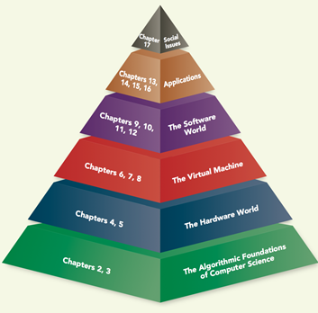
Figure 1.9 Organization of the Text into a six-layer hierarchy

Slide 34
Summary
Computer science is the study of algorithms.
An algorithm is a well-ordered collection of unambiguous and effectively computable operations that, when executed, produces a result and halts in a finite amount of time.
If we can specify an algorithm to solve a problem, then we can automate its solution.
Computers developed from mechanical calculating devices to modern electronic marvels of miniaturization.

